Slide 1
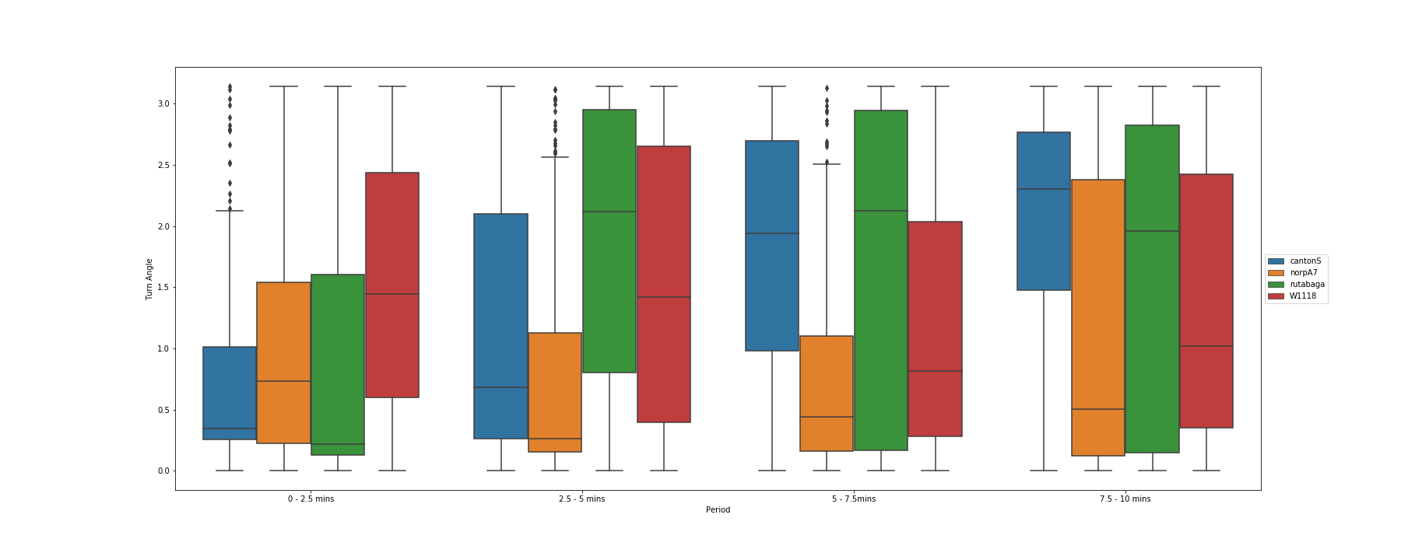
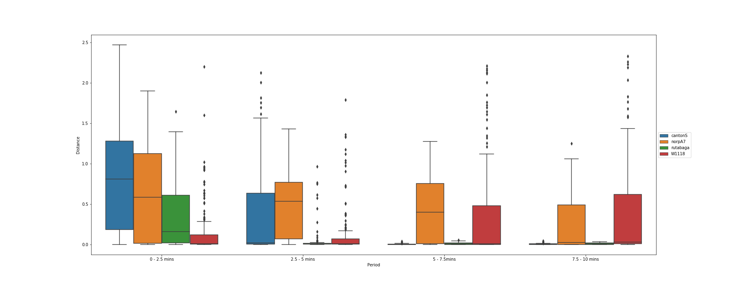
A)
B)
Figure 2: Boxplots panels represent two key variables (A) Turn Angle and (B) Distance of four fruit flies’ genotypes (cantonS, norpA7, rutabaga, W1118) across four consecutive 2.5-minute intervals (10 minutes)

Slide 2
Table 2: Ordinary Least Square (OLS) Regression Results of Distance and Turn Angle assuming both Period and Genotypes as significance at the p<0.05 level
OLS Regression Results
Formula | R-squared | Adj. R-squared | F-statistic | P>|t|
Distance ~ Period * Fly Type | 0.264 | 0.259 | 56.96 | 0.000
Turn Angle ~ Period * Fly Type | 0.125 | 0.12 | 22.78 | 0.000

Slide 3
Table 3: Results of repeated measures ANOVA, with Turn Angle and Distance Angle respect to Time as the between subject factors at the p<0.05 level
Genotypes | Variables Respect to Time | PR(>F) (p-value associated with the F statistic)
cantonS | Turn Angle | 5.039793e-29
 | Distance | 1.255019e-62
norpA7 | Turn Angle | 0.007682
 | Distance | 4.549592e-13
rutabaga | Turn Angle | 4.630760e-14
 | Distance | 1.253609e-48
W1118 | Turn Angle | 0.007946
 | Distance | 9.406055e-08

